Slide 1

Object Tracking
Mikołaj Leszczuk, Jakub Nawała
Notes:
Object detection is scanning and searching for an object in an image - applicable for static images
Object Tracking is like you are spying on someone and want to follow objects associated with this person - applicable for videos

Slide 2
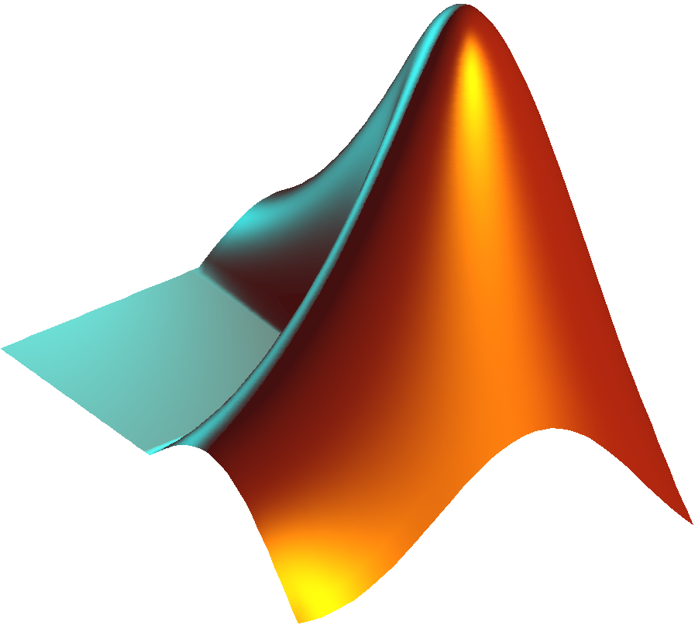
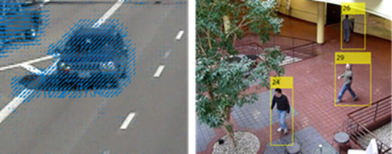
Object Tracking
Process of locating and tracking a (moving) object (or multiple objects)
Fundamental pre-processing step in Computer Vision
Requires a video
Notes:
Locating an object can be done using an object detector. But it can also be done manually.
Tracking can mean not only to know object’s location, but also being able to estimate its speed and/or where it is going (its path and direction).
It can be much faster than object detection if we do not care what is the identity of an object. In this case, the algorithm can simply measure temporal features of the video. It will work very fast (in real time).

Slide 3
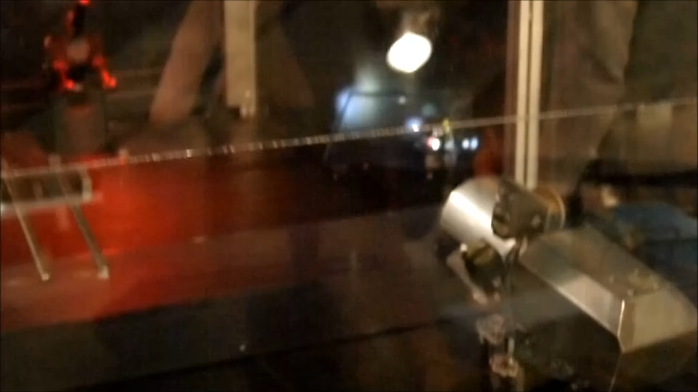
Applications
Commonly added to e.g.:
Object detection
Process of modelling changes in object’s look

Slide 4
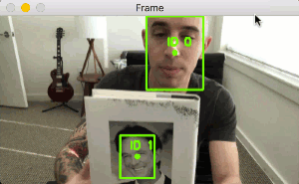
Applications
Human-computer interaction
Gesture recognition
Eye gaze tracking
Traffic monitoring
Surveillance systems
Person counter
Medical imaging
GIF taken from this article at pyimagesearch.com
Notes:
Video - notice what happens when an object disappears from the scene. Also notice what happens when the guy turns the book 90 degrees.

Slide 5


Theoretical Fundamentals
Given an initial position, track object position in subsequent frames
In a non-ideal case, object detection needed from time to time
Unique IDs for each tracked object needed
Time consuming process
One can track anything
If there is no dependency on an object detector
Notes:
Time consuming:
True if one is using an object detector
False if only temporal features of the video are used
Shape - some trackers are also able to follow shape changes
Ideal tracker: if there are no new objects, it should be able to track given an initial location. Thus, object tracking can be used to speed up real-time object detection. Once an object got detected, use the bounding box and run a tracker.
Importantly, we can act as an object detector by simply selecting the region of interest. Here is a video how one can do it in OpenCV. This makes everything fast. What is more, one is not limited to the classes an object detector can detect.
One can track anything - not true if tracking is based on object detection. An object detector is always trained for some classes.

Slide 6
Use initial bounding boxes of objects and compute centroids
Assign unique IDs to centroids
Calculate the Euclidean distance between the centroids
Update centroids
the lowest distance method
Register new objects
Deregister old objects
Go back to step 2.
Centroid Tracking
Dependent on object detector
Steps taken from this article at pyimagesearch.com
Notes:
Centroid - x,y-coordinates of the centre of a bounding box
1. Bounding boxes can be given by hand or by using an object detector
1.a is performed only for the first frame
3. Assumption - a given object can move between frames; the distance between its centroids for subsequent frames is smaller than distances from its centroid to centroids of any other objects
4. Only if there are any new objects
5. Deregistering - remove a given ID an object associated with it is not visible in N subsequent frames

Slide 7
Problem Complexity
Still being improved
Source of difficulties
Information loss, caused by transferring from a 3D world into its 2D representation
Capturing distortions
Changes in lighting
Computational complexity of convolutional neural networks (if an object detector used)
Frame rate of object detectors limited even on modern graphics processing unit
Notes:
3D - > 2D: swapping an object ID is not so difficult
Capturing distortions - blurring, noisiness etc.
Changes in lighting - for you it doesn't matter if a person is standing in a shadow or not - a camera, however, sees it as a different set of pixel intensities.
Computational complexity - running an advanced object detector for each frame takes time! Of course, there are object trackers that do not run object detector for each frame.

Slide 8
Problem Complexity
Extra complexity when
Objects moving fast relative to the frame rate
Tracked objects changing orientation over time
Complex training for deep learning
Motion model helps with the changing orientation
how would an image look like for different object motions
Notes:
Changing orientation - I can stand facing a camera, but I can always turn around, What happens if an object tracker is based on a face detection?
Motion model - knowing how something is moving, we can deduce its image
Using a deep-learning approach to create a tracker from the scratch, requires you to have a big amount of annotated videos. Annotated means here that you know a bounding boxes for each object in the video.

Slide 9
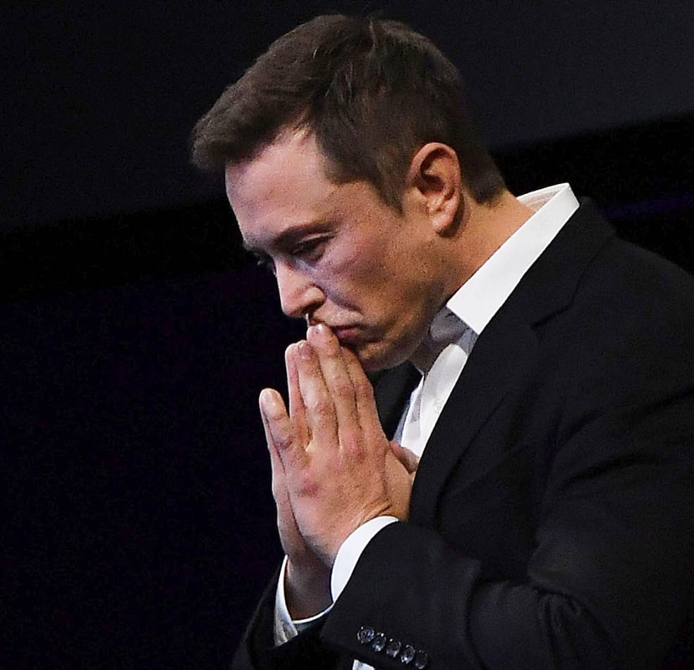
Elon Musk’s Doubtful Sense of Humour
Elon Musk stated in 2017 that robots will move so fast that you will not be able to see them without a strobe light
That would be a nightmare for object tracking as well…
Notes:
Moving fast - Elon Musk stated in 2017 that robots will move so fast that you will not be able to see them without a strobe light. That would be a nightmare for object tracking as well… Link to the article detailing Musk’s doubtful sense of humour.

Slide 10

2D object: 2D transformation of object image (e.g. initial frame):
Affine transformation
Homography
Applies to planar objects
3D object: aspect depending on its 3D position and orientation
Motion
Model Examples
Notes:
Aspect meaning an appearance of an object after some transformation.

Slide 11
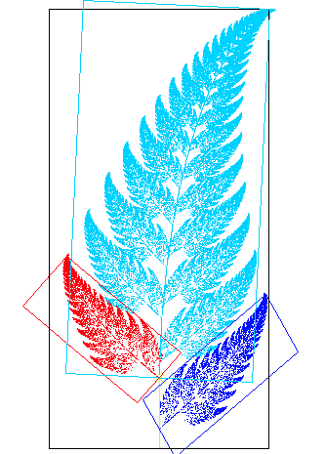
Affine transformation
Preserves
Points
Lines
Planes
Examples
Translation
Scaling
Reflection
Rotation
Image taken from Wikimedia Commons and licensed under the Public Domain license.
Notes:
Each leaf in this picture is an affine transformation of any other leaf.

Slide 12

Motion
Model Examples
Deformable objects:
Covered with mesh
Object motion defined by a position of mesh nodes
Video compression:
Key frames divided into macroblocks
One tracks a motion of macroblocks
This motion is needed to recreate the video
Notes:
Modern video compression codecs (H.264 and H.265) utilise motion models.
Our team has been working with Netflix to propose something different. Compression based on a subjectively perceived quality.

Slide 13
The Most Popular Approaches
Mean Shift Tracking
Given a region from the previous frame, find the most similar region in the current frame
Proposed in 1975
i-th frame
i+1-th frame
Notes:
Mean shift tracking:
this video nicely explains the topic.
A more formal description of the mean shift algorithm can be found at en.wikipedia.org.
If you think all this object tracking is a new thing, think twice…
Algorithm based on some similarity function (of a given feature - e.g. histogram of luminance values)

Slide 14
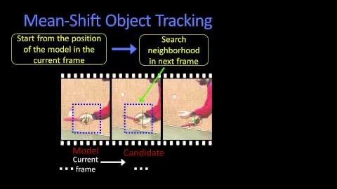
This Video Nicely Explains the Topic of Mean Shift Object Tracking

Slide 15

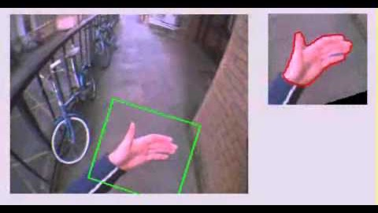
The Most Popular Approaches
Contour Tracking
Best Understood in Action
Minimizing object energy
Using gradient descent, & by doing so iteratively evolving initial contour initialized from previous frame to its new position in the current frame

Slide 16
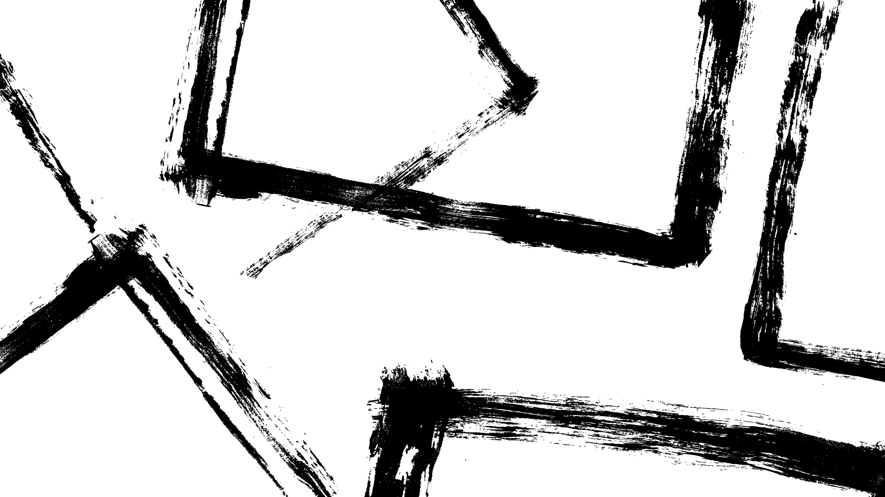

Frame Differencing
Comparing 2 subsequent images
Computing differences between them
Using threshold to distinguish noises from a real movement
Method especially useful in situations when:
Background staying still
Tracking path of all moving objects

Slide 17
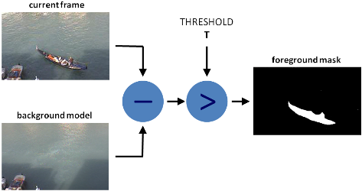
Frame Differencing
A.k.a. foreground detection
Extracting image foreground for further processing
in this case, for tracking
Applicable when background is static

Slide 18
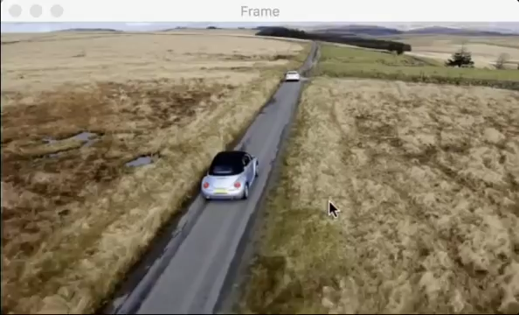
Live Demo
You can run this demo on your computer using this tutorial from pyimagesearch.com.

